Slide 1
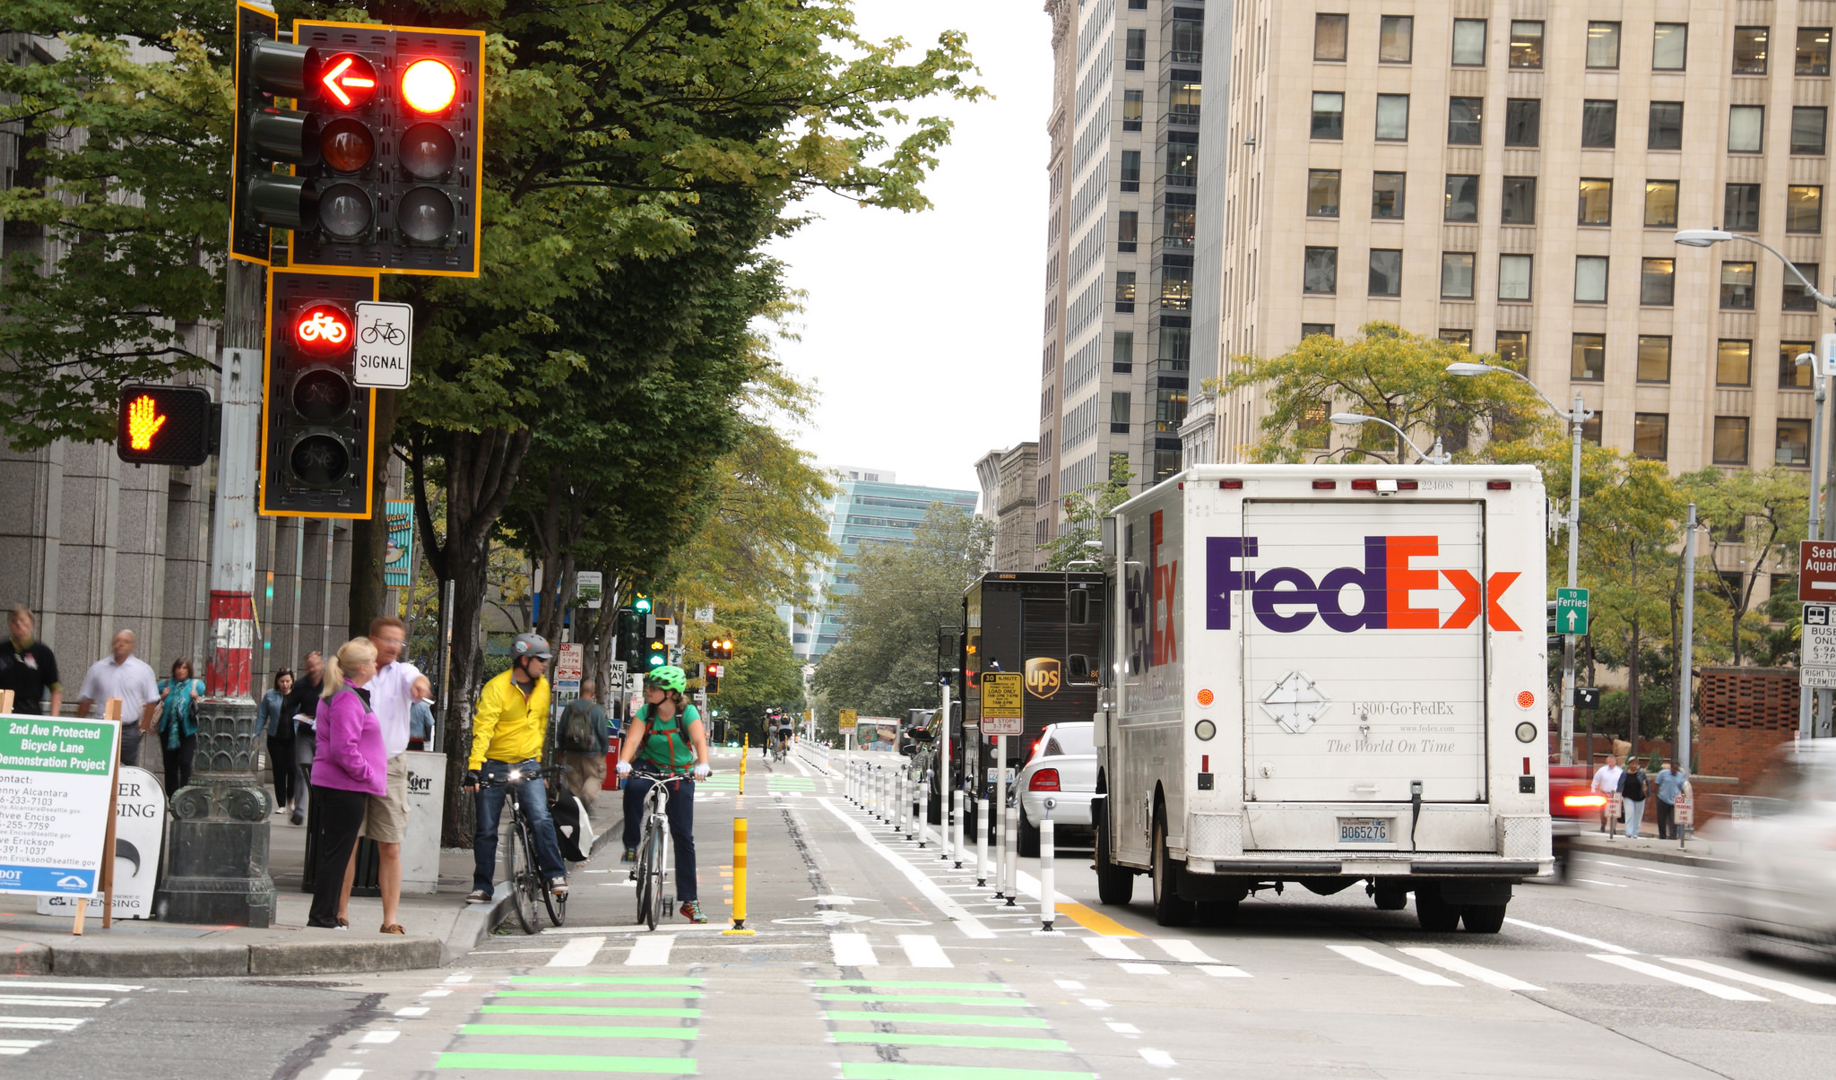

CBD Curbspace & Multimodal Decision Framework Study
Seattle Planning Commission
Meghan Shepard, Michael James
November 13, 2014
Notes:
Thanks for this opportunity to check in with you today.
I’m Meghan, He’s Michael.
We’re early in our projects to help us investigate how we allocate our right-of-way and curbspace now and how we want to in the future.

Slide 2
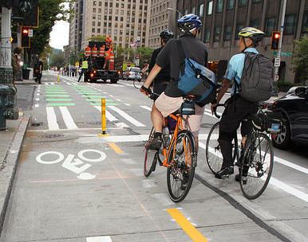
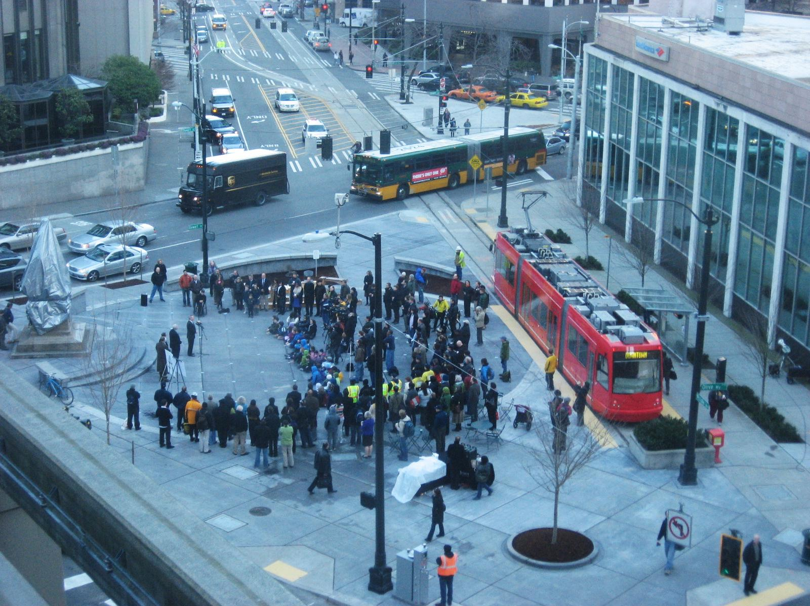
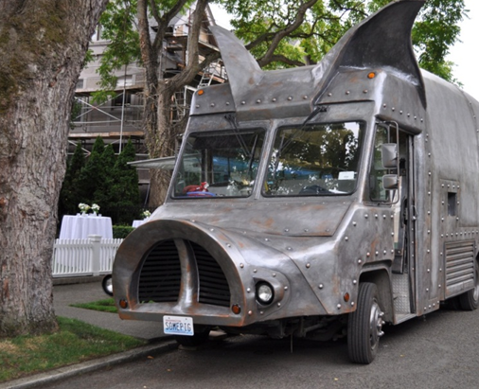
SDOT’s mission & vision
Mission: delivering a first-rate transportation system for Seattle.
Vision: a vibrant Seattle with connected people, places, and products.
2
Notes:
ROW allocation and curbspace management are closely tied and key contributors to how we achieve SDOT’s vision of a vibrant Seattle with connected people, places and products.

Slide 3
Presentation overview
Multimodal decision framework study
CBD curbspace study
Your feedback
3
Notes:
So today we’ll walk through Michael’s project to develop multimodal policies and spend additional time on the CBD curbspace study.

Slide 4
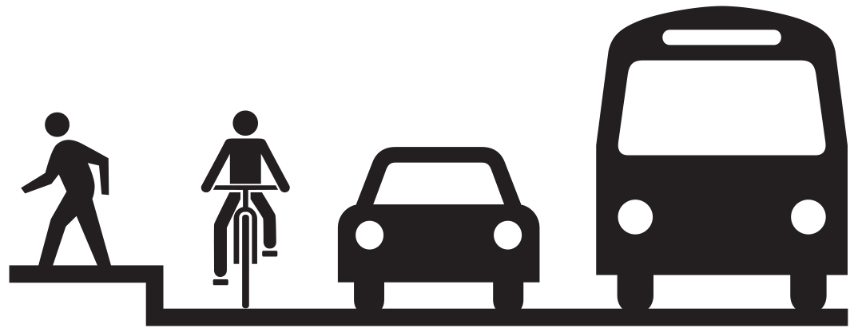
Multimodal Decision Framework
Considering a Modal Hierarchy strategy in the Comprehensive Plan
  Policy development
  Framework process and diagram
Inform our Complete Street policies
  Making the best use of the right-of-way
Notes:
Michael

Slide 5
Framework Example
Notes:
Michael

Slide 6
Scope
Context review of existing plans/policies
Peer city review (Chicago, DC, New York, and SF)
Framing scoping
  How will the tool be used and by whom?
  Opportunities and constraints
  How does it relate to other Comp. Plan requirements?
Notes:
Michael

Slide 7
Scope
Development of three alternative approaches
  Urban growth strategy
  Multi-criteria assessment
    Environment, economy, safety, mobility, health
  Hybrid
Model three multimodal corridors
Draft goals and objectives
Develop Framework & Diagrammatic Strategy
Notes:
Example of a policy from San Francisco
POLICY 1.3
Give priority to public transit and other alternatives to the private automobile as the means of meeting San Francisco's transportation needs, particularly those of commuters.

Slide 8
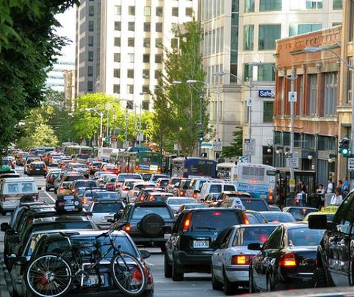
Why a curbspace study?
Increasing competition for limited space
Cumulative project impacts
Need for clearer policies, decision making criteria, and procedures
8
Notes:
Meghan
In addition to looking at how we use the full right-of-way, we are taking a much closer look at allocation of the curb lane.
We use the curb lane for all different types of uses: we move people on bikes, buses and car, we move goods in trucks, we get access to our destination, we get lunch from a food truck.
Many downtown projects will affect the currently supply – we want to lay everything over and take a clearer look.
We want to create a clearer and more predictable decision making process and clarify our policies.

Slide 9
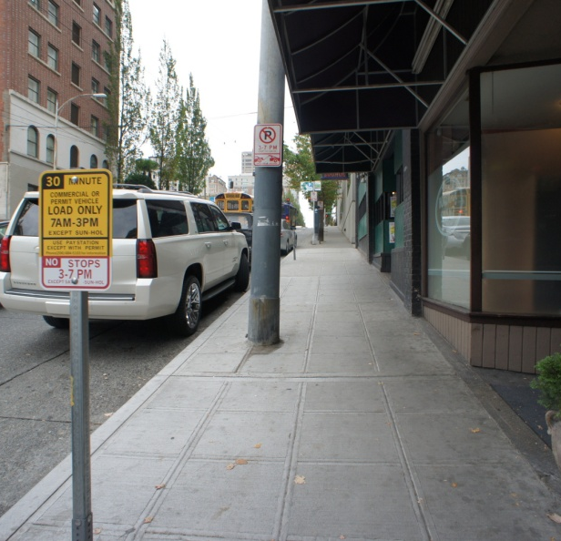
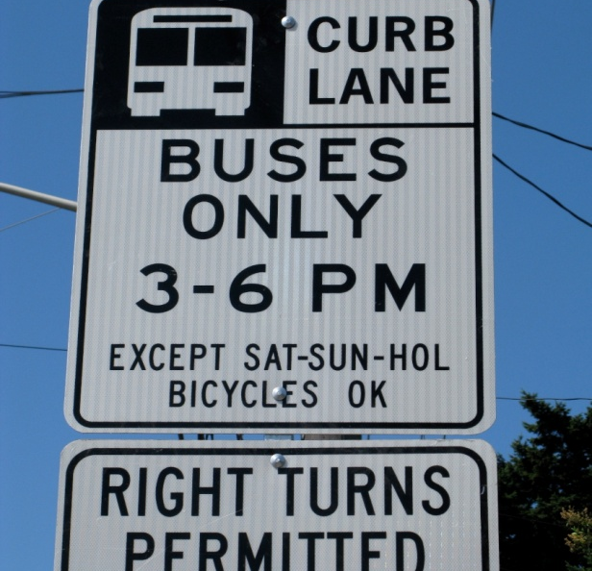

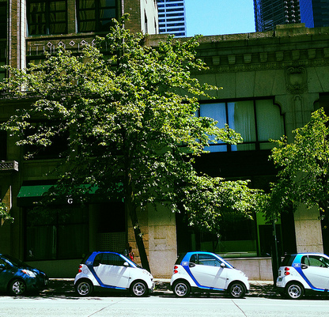
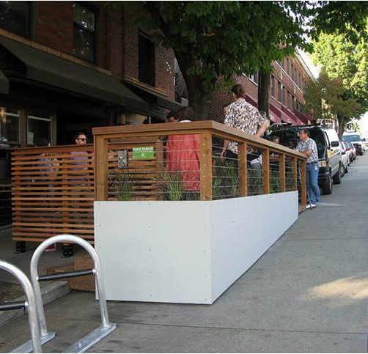
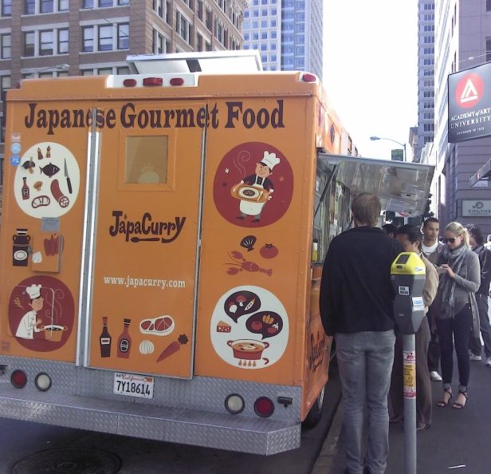
Curbspace Policies and Uses
Notes:
The policy piece is foremost.
We have found over 280 separate policies that speak to curbspace allocation downtown.
Current Comp Plan and transit, loading, short-term parking.
Do not speak to new uses.
No guidance on differences for different neighborhoods or different street types.

Slide 10
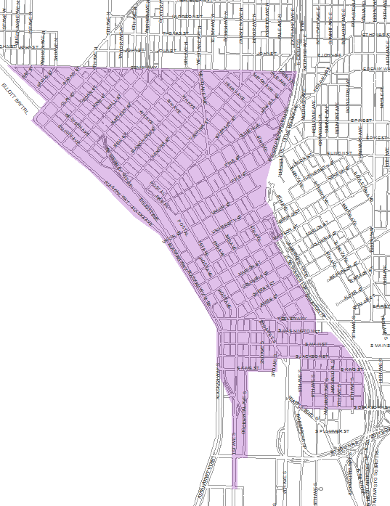
Project area
10
Notes:
This is our study area.
We assume it’s a starting point.

Slide 11
Scope of Work – Key Deliverables
Existing conditions
Curbspace policy recommendations
CBD curbspace decision-making framework
Future conditions scenarios
Notes:
4 key deliverables
What we are doing now is investigating what we have and how we allocate it.
By the end of December, consultant will recommend curbspace policies that we will continue to investigate through the comp plan.
Early in 2015 and based on those policy recommendations, they will provide a decision-making framework we can use when making curbspace decisions.
Finally, they’ll overlay the known transportation and construction projects over our current curb uses, see what’s left, and recommend some additional management strategies for us to investigate. Use CVLZ example.

Slide 12
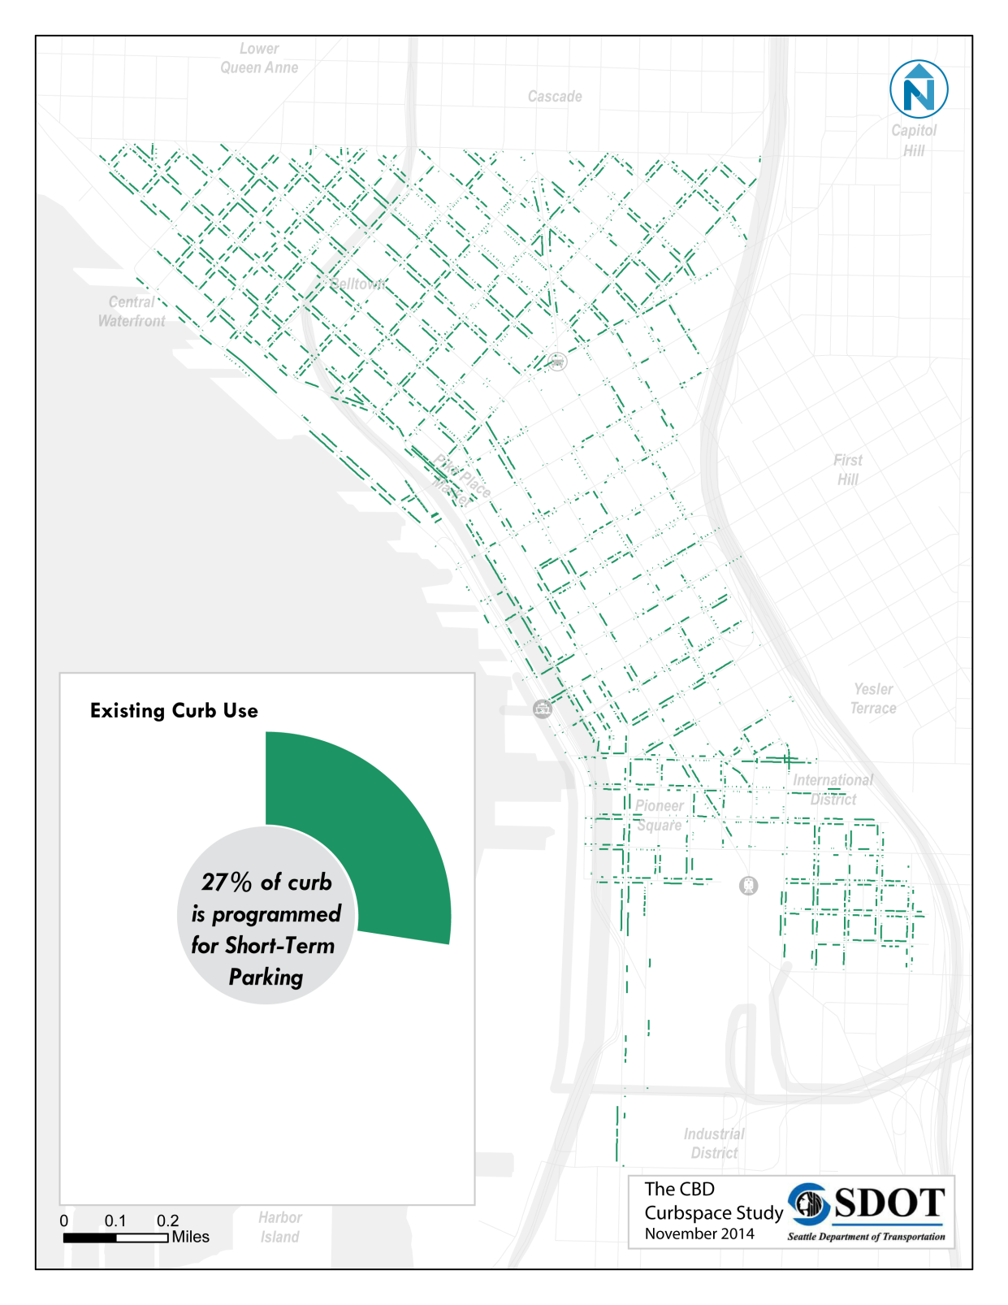
Short term parking
1/3 of CBD curb is consistently short-term parking.
Concentrated in neighborhoods outside commercial core
Notes:
Here is what we are learning.
This is low – people think it’s much higher.

Slide 13
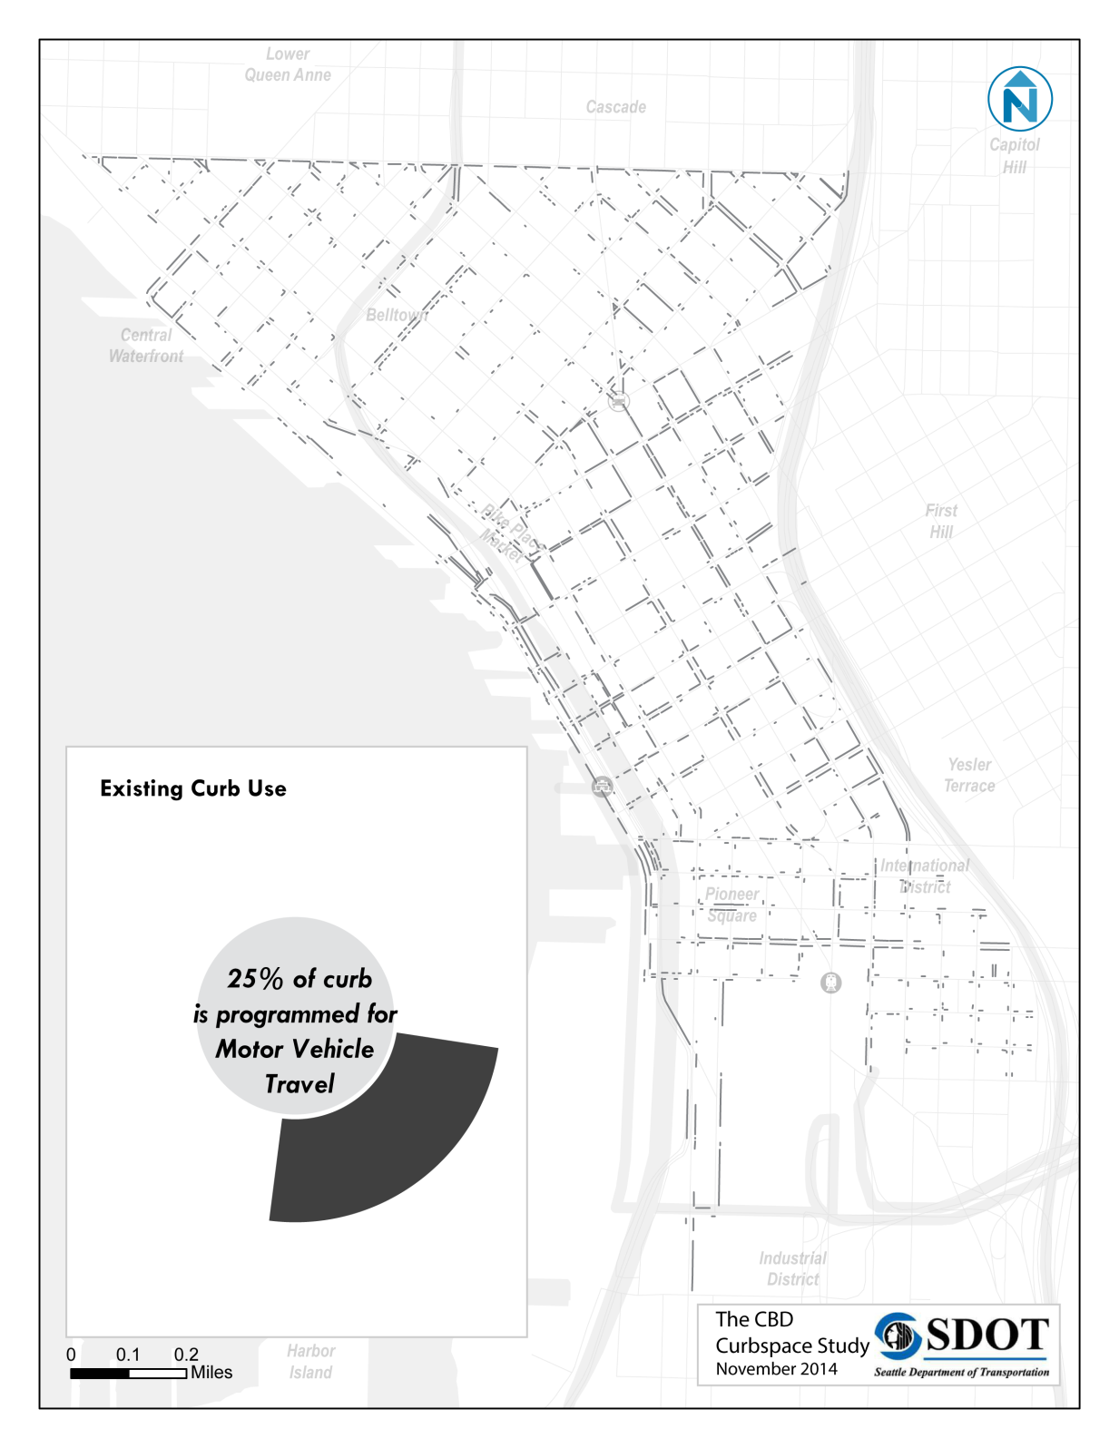
Travel lanes
Motor vehicle through travel:
  Travel lanes
  Turn lanes
    Peak period bus/turn lanes
  On/off ramps to highways

Slide 14
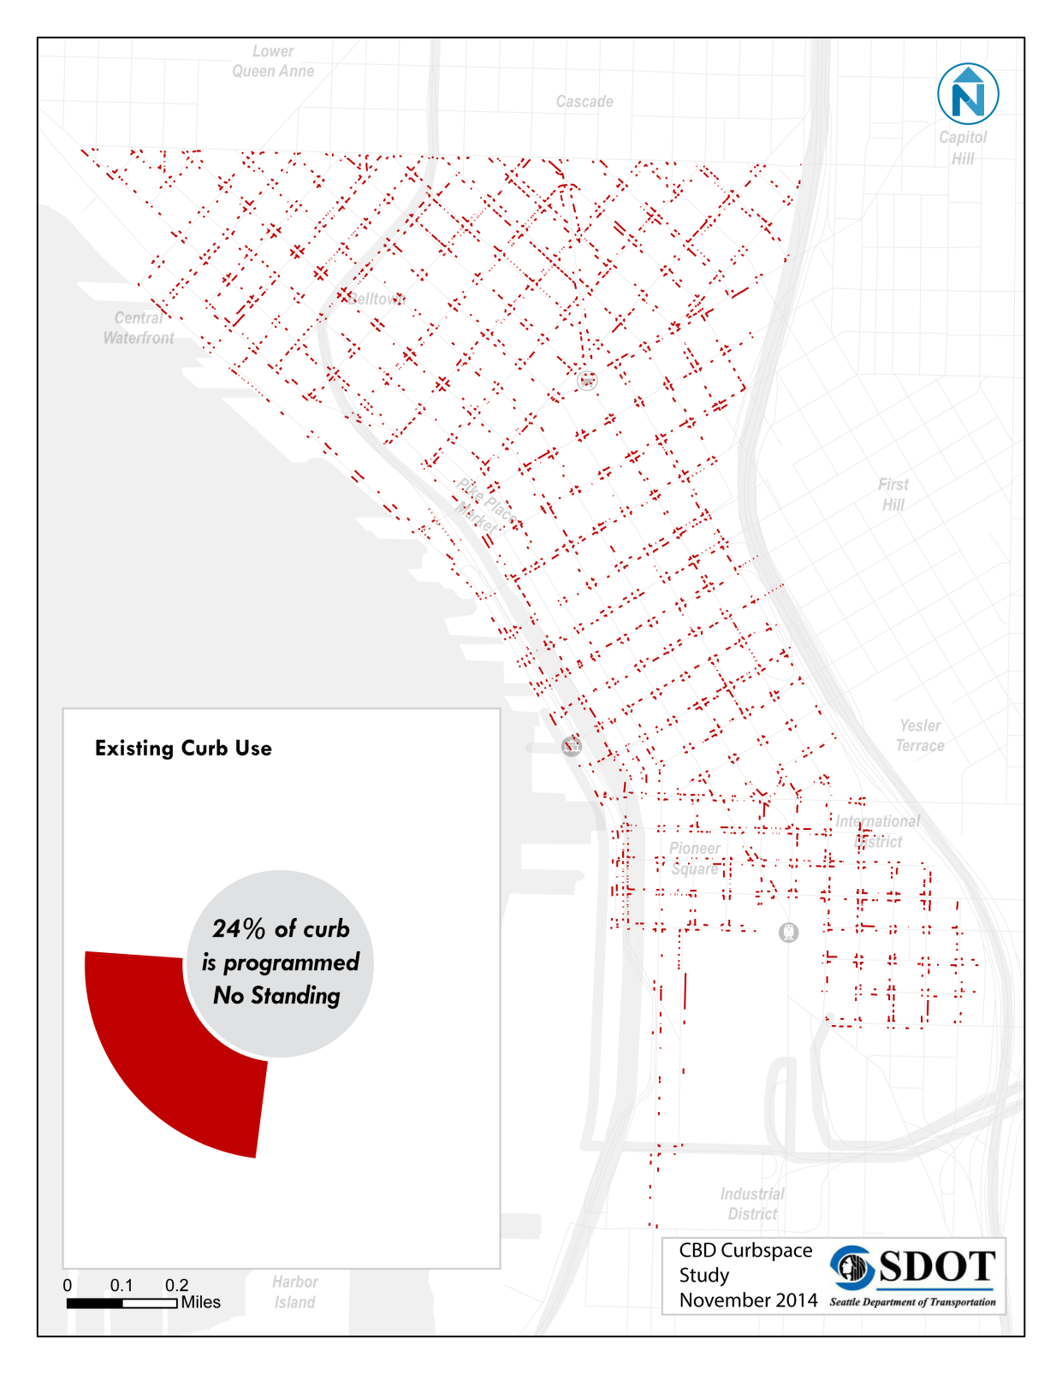
No Standing Zones
Pedestrian Mobility
  Crosswalks
  Curb Ramps / Bulbs
Driveways
Hydrants
Bicycle Mobility/Access
  2 Bikeshare Stations
Curbside Activation
  Parklet
    Chinatown / ID
Notes:
Pedestrian space dominates (half of above) followed by driveways ~4% of total CBD curb

Slide 15
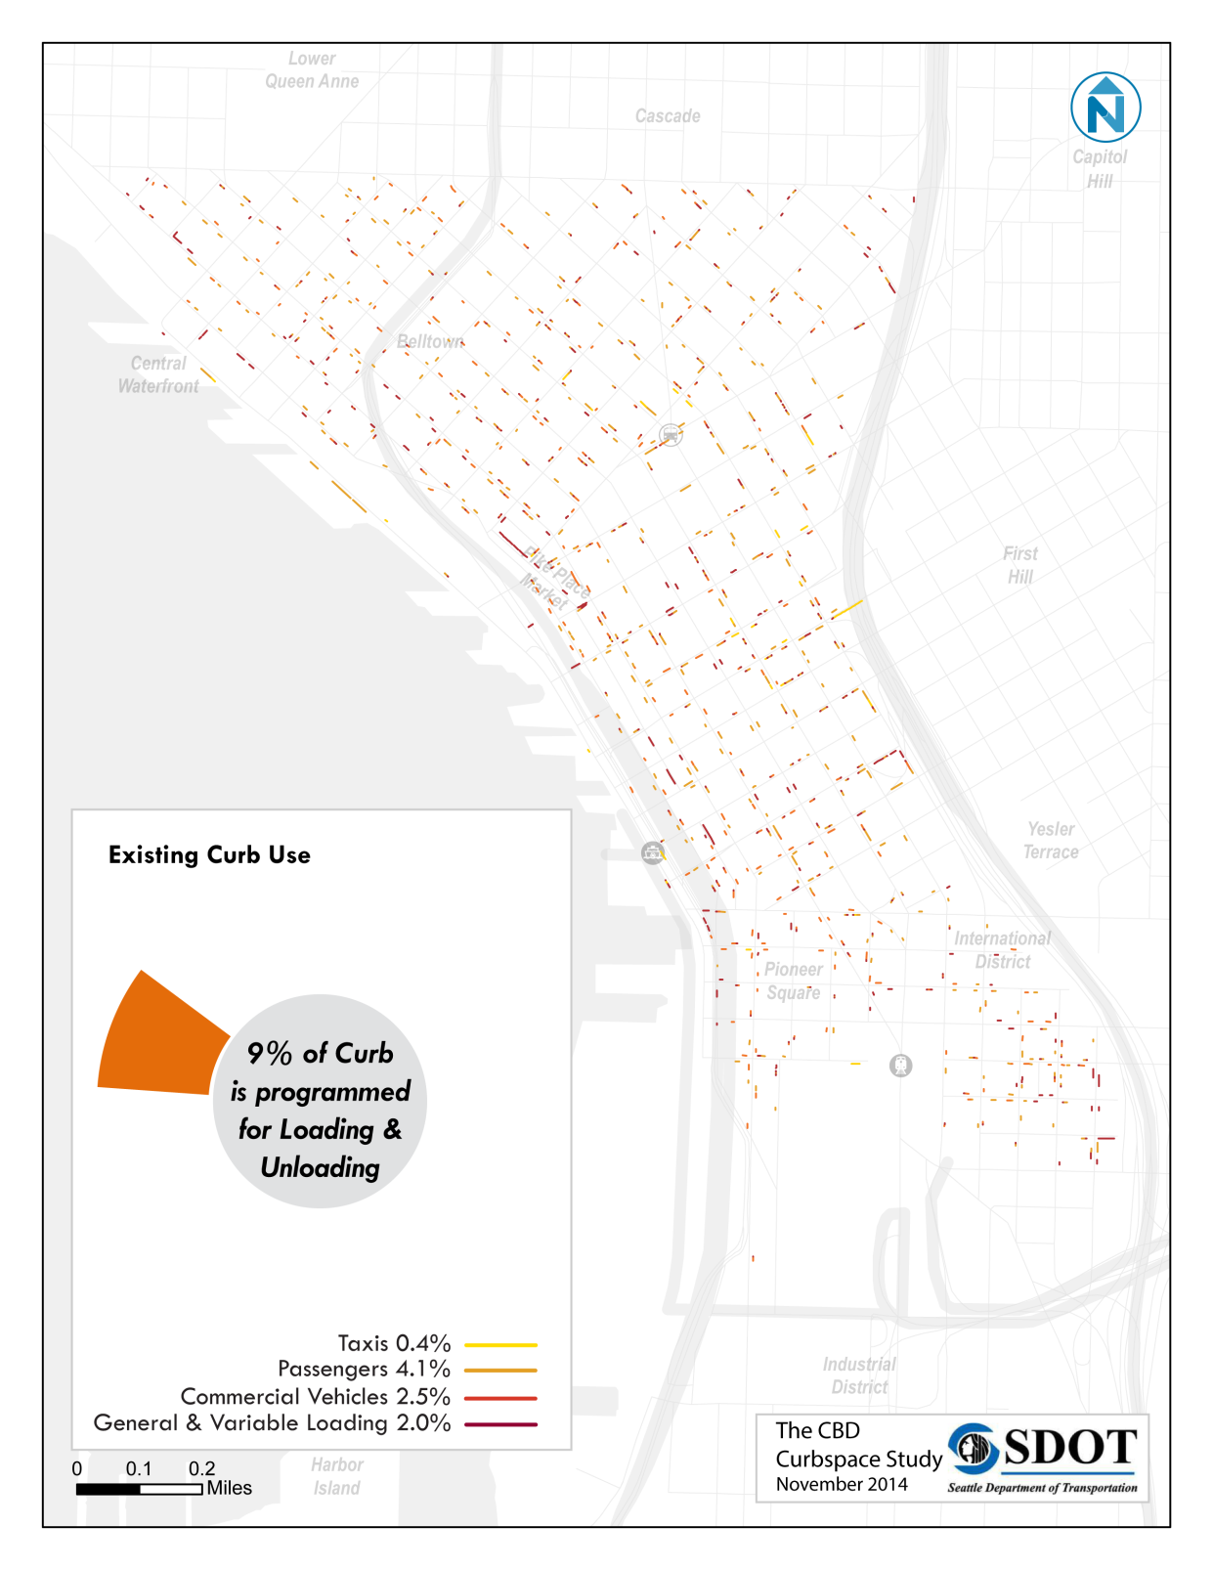
Loading/ unloading
Loading uses can vary throughout day:
  Commercial in early AM, passenger all other times
Passenger loading zones majority
Zones are dispersed throughout CBD

Slide 16
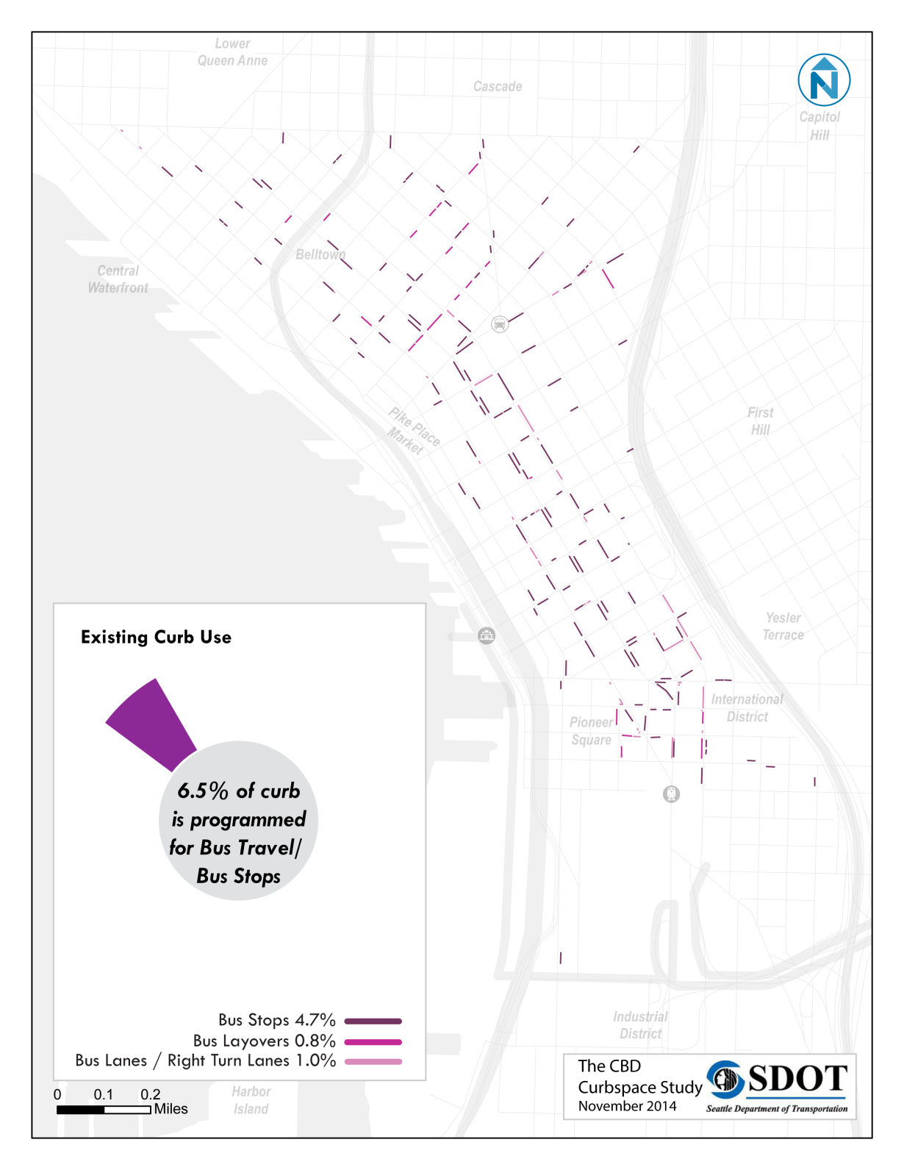
Surface transit
Peak period bus lanes
Bus layovers
  1% of CBD Curb
Bus lanes serve
bike and bus mobility

Slide 17
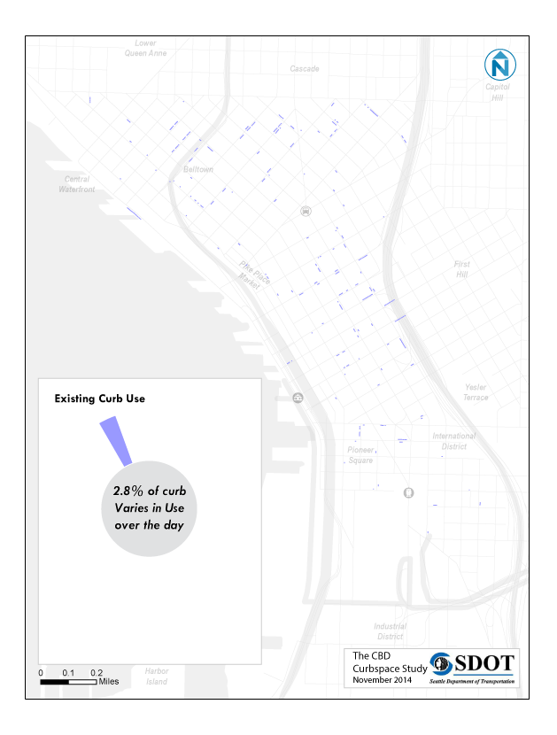
Variable Restrictions
Short term parking most of the day.
Serves other uses during specific hours:
  Bus stops / layovers
  Loading / unloading
  Food Truck Vendors
  School bus access
  Precinct parking
  Carpool parking
Notes:
Shift during AM/PM to travel for MVs and transit and some loading uses switch to transit/MV travel\

Slide 18
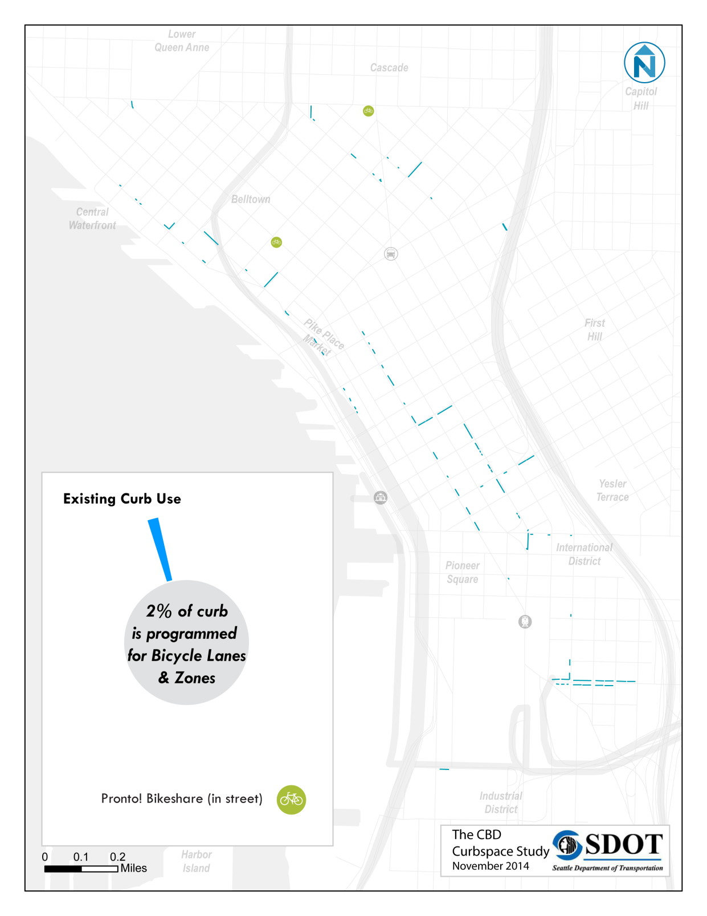
Bicycle facilities
Bike lanes and two-way protected bike lanes
2nd Avenue
  Parking adjacent to moving lane
Spring Street
  Angled parking on opposite curb

Slide 19
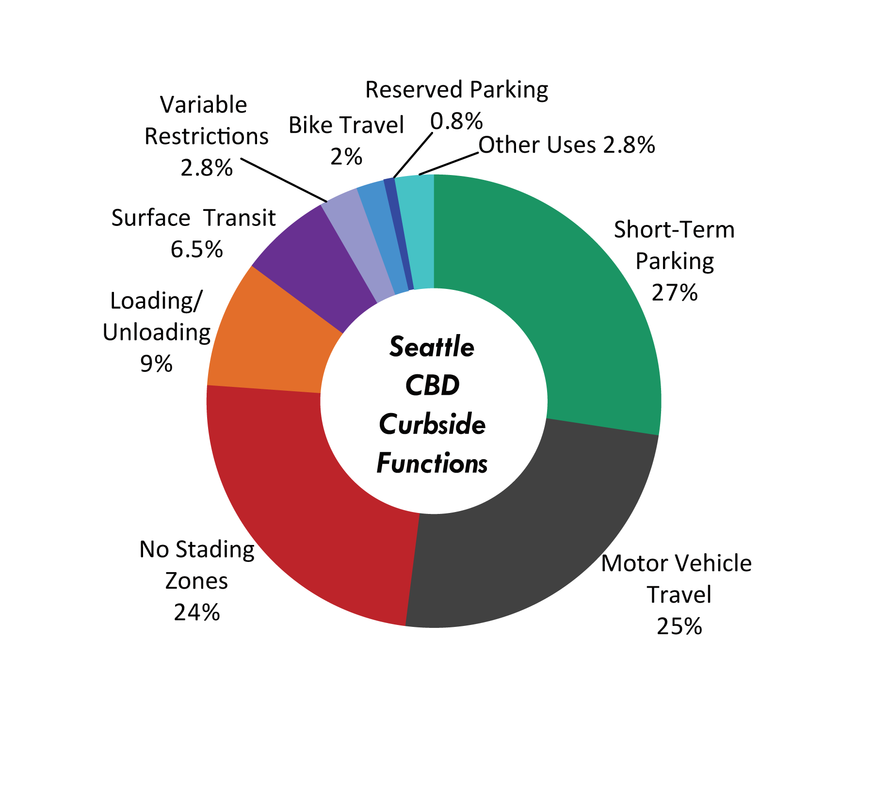
Existing conditions summary
19
Notes:
Looking how curbspace currently used.

Slide 20
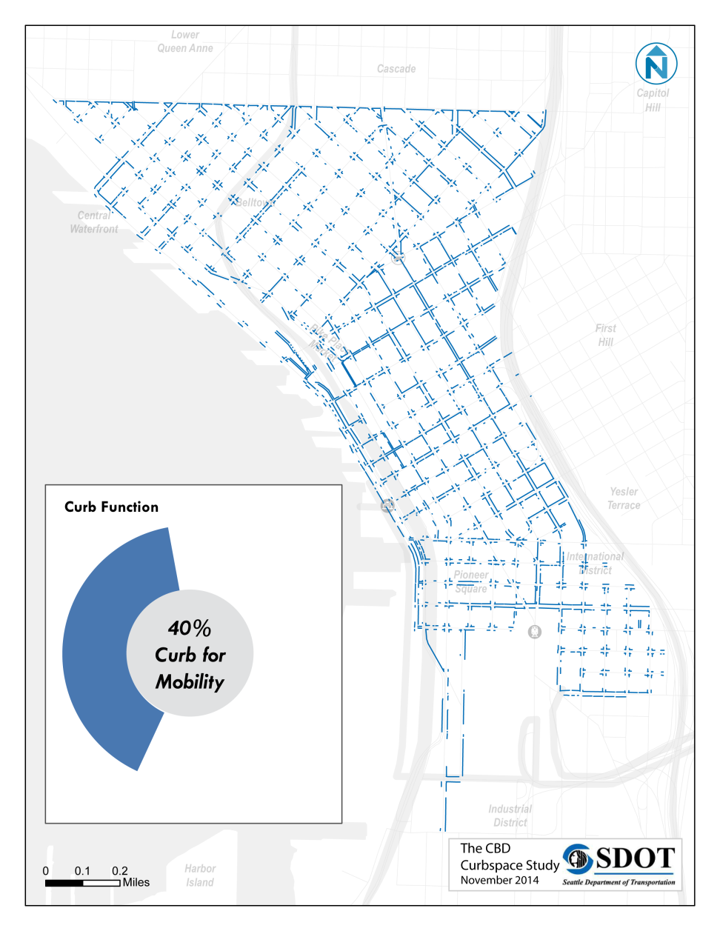
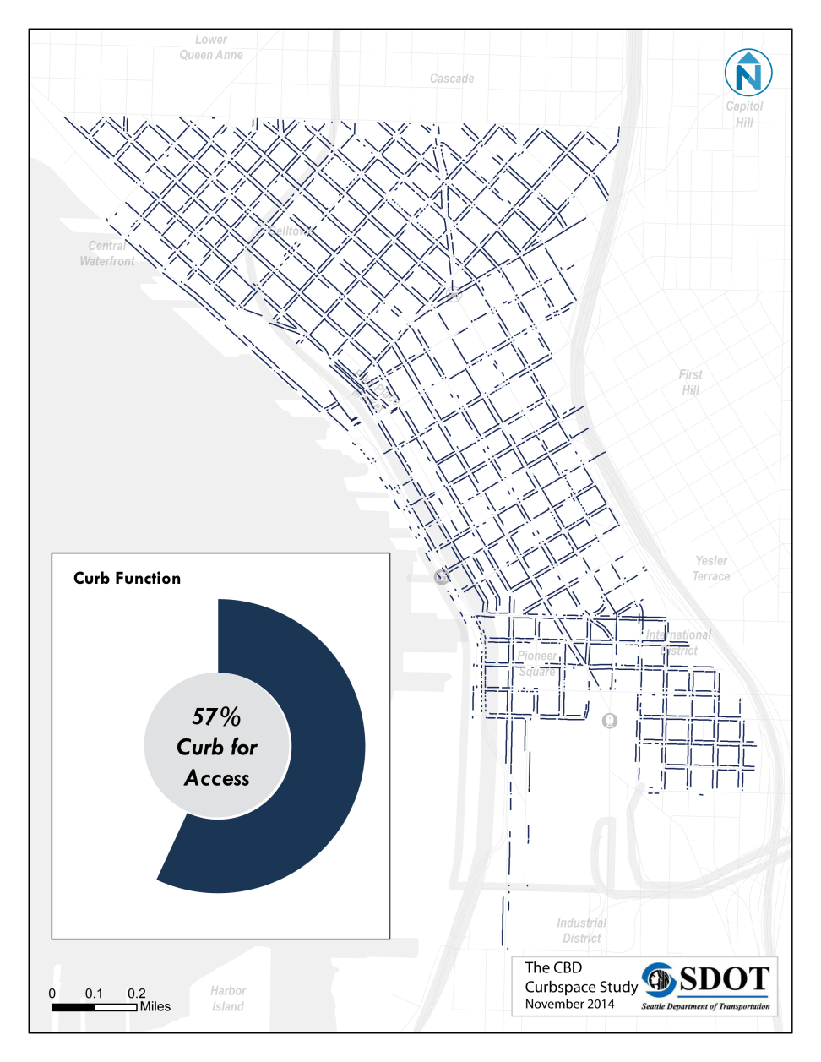
Curbspace Function

Slide 21
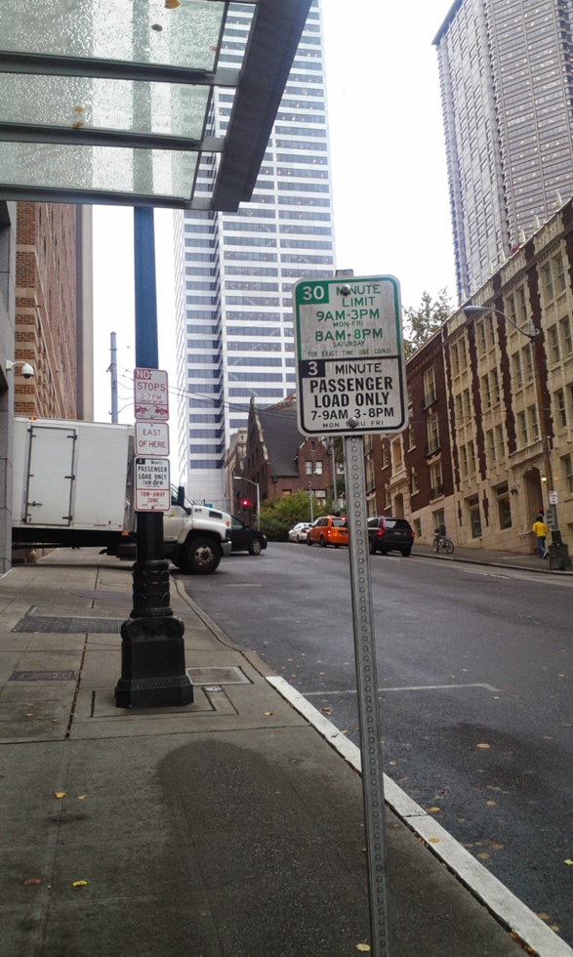
On-going conversation
Stakeholder interviews
Intercept surveys
Briefings
Notes:
See if there is any conversation to be started with this group.

Slide 22
Next steps
Date | Activity/action
Mid November | Curb Users Intercept Survey Conducted
December | Key policy recommendations
March | Study delivered
22
Notes:
Insert a project timeline. Clarify the process and opportunities for engagement/feedback.

Slide 23




Questions?
meghan.shepard@seattle.gov | (206) 684-4208
http://www.seattle.gov/transportation

